Slide 1

What is animation?
Animate: Bring to life

Slide 2
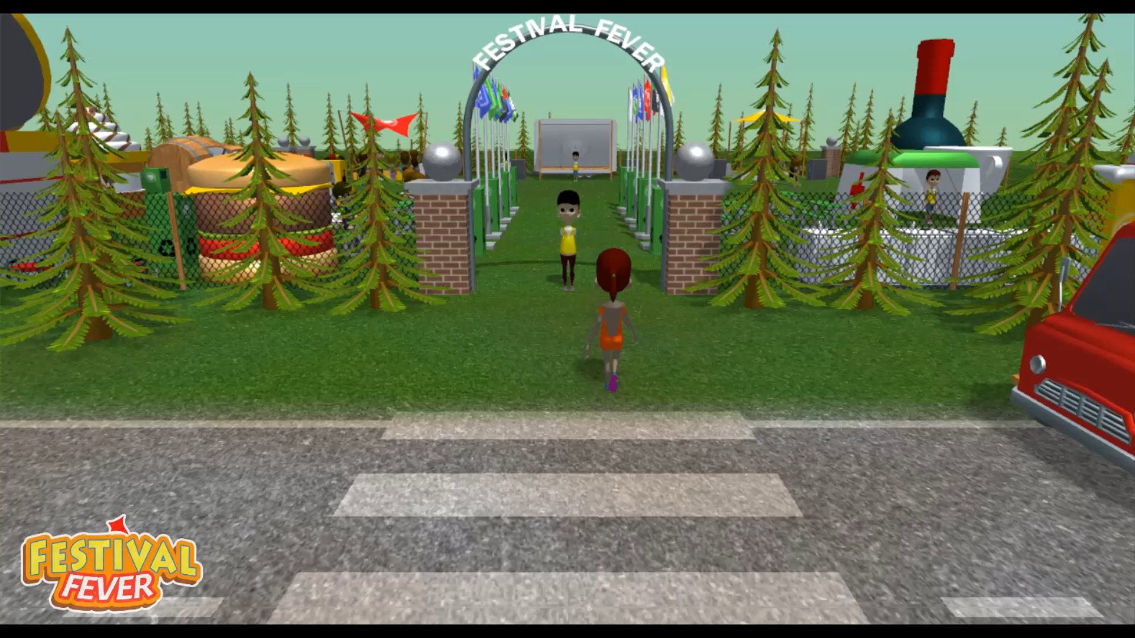
Spot Animation Techniques
Write down all the animation techniques you can spot in the video

Slide 3
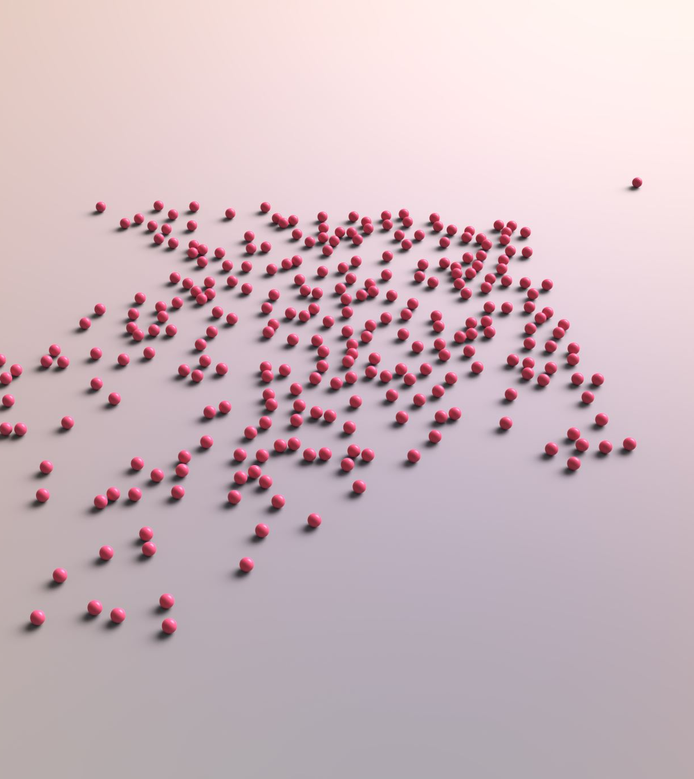
Did you get them all?
Character animation
Object animation
Vegetation animation
Procedural animation
Bouncing facilities
Cloth simulation?
UI?

Slide 4
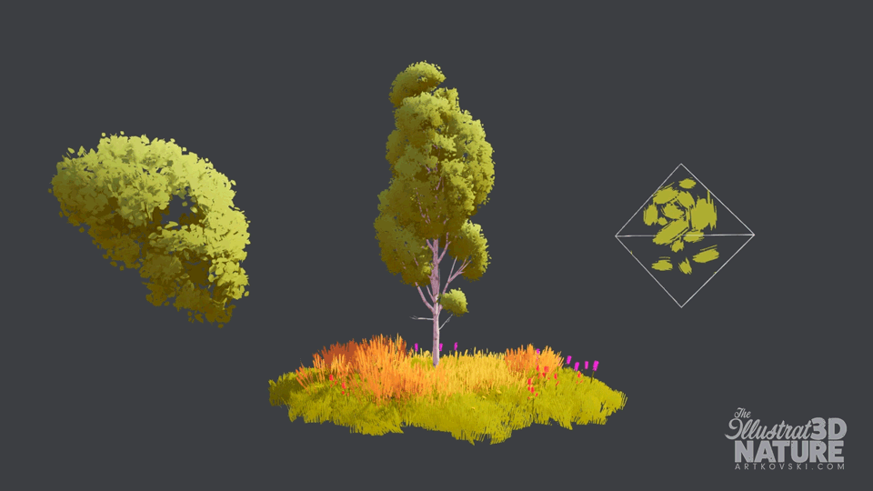
Procedural Animation
What is procedural animation?
Examples of procedural animations?

Slide 5

Did you get them all?
Vegetation (trees and grass swaying)
Cloth
Ocean waves
Particles
Hair
Clouds
Character animation?
Inverse Kinematics?
More?

Slide 6

Shaders are perfect for procedural animation but why?
CPU must wait for FPU to process instructions – Slow That is why we had to design dedicated graphics cards!
GPU is optimized for floating points - Fast

Slide 7
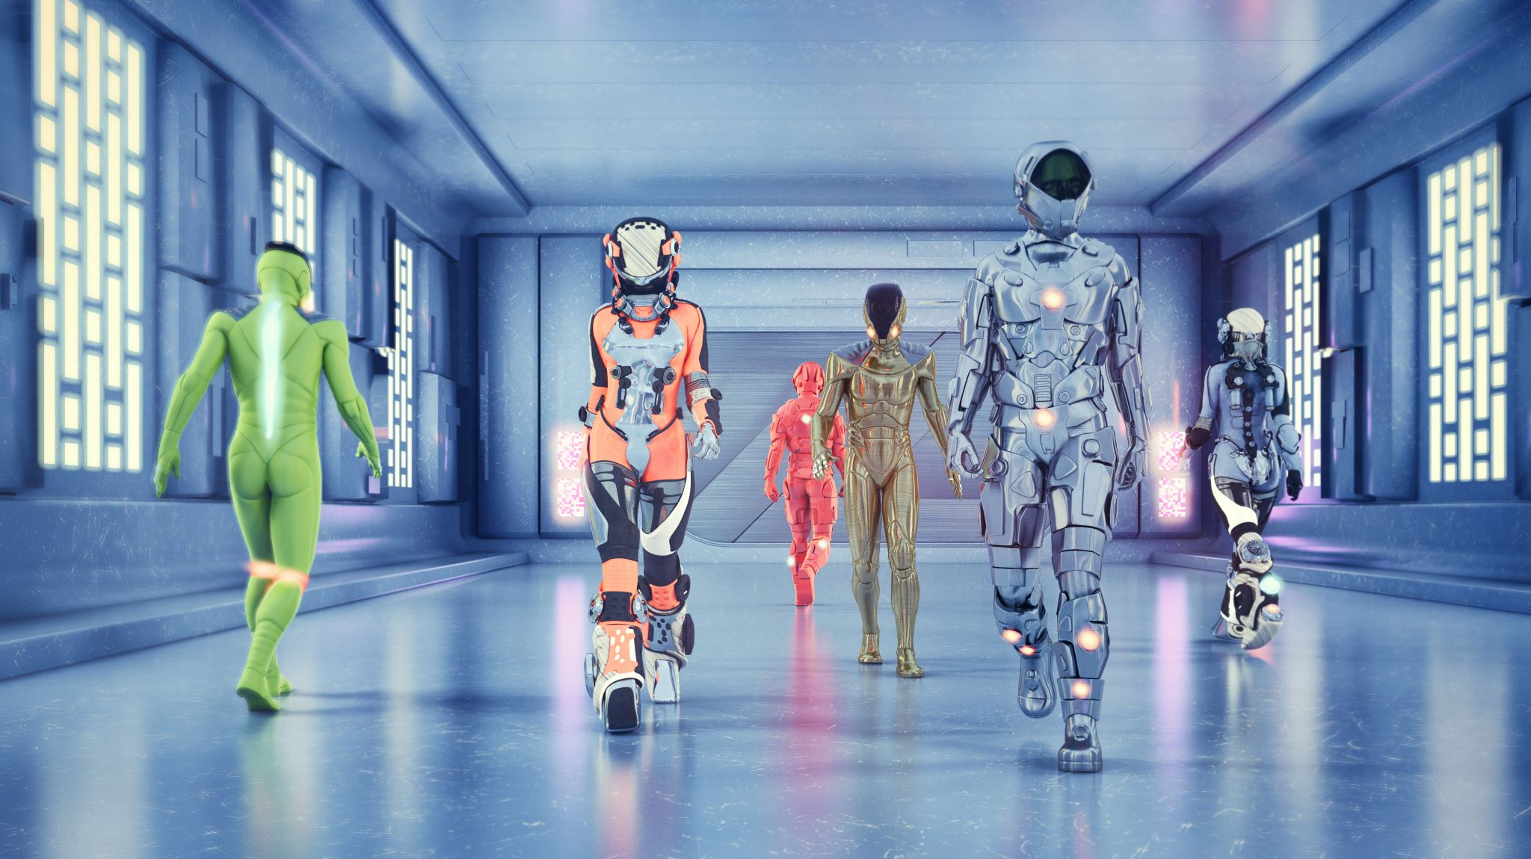
Simulations vs Animation
What's the difference?

Slide 8
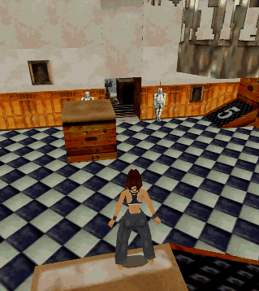
Camera Animation How do you animate a dynamic camera for a 3rd person view in a game like Tomb Raider?
Technical Challenges:
Character is going inside a house.
Character rotation around and an obstacle like a big tree is in the way?
Can we use triggers that will affect distance between camera and character?
What are the disadvangtes?

Slide 9
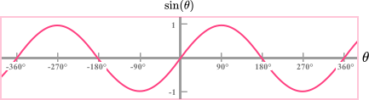
Procedural vs Keyframe Can we tell the difference?
Why is sine & cosine great for procedural animation?

Slide 10
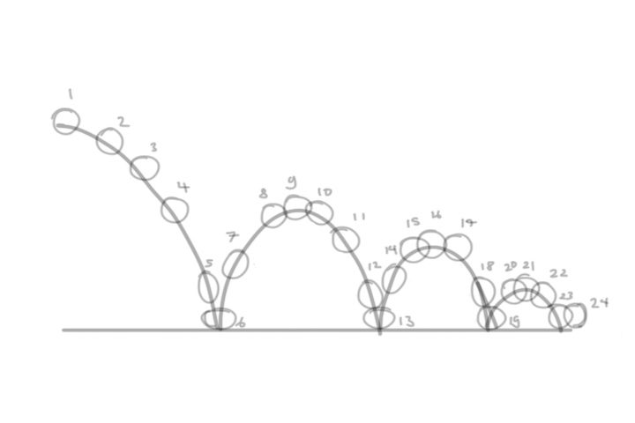
Can you spot any similarities?
Use of abs() and a damper will make a sine wave look like a ball bouncing

Slide 11
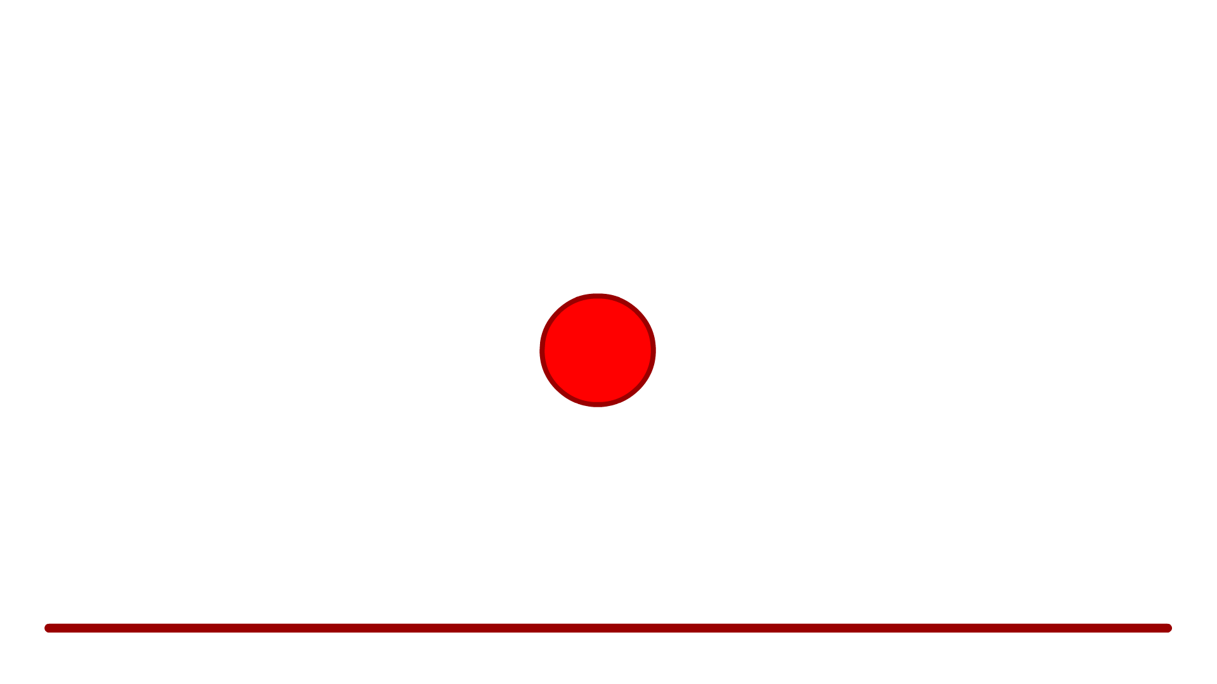
Bouncy Movements?

Slide 12
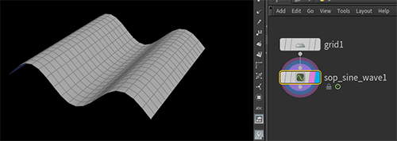
Simple Waves

Slide 13

Simple Effects?

Slide 14

Realistic Effects?
https://www.youtube.com/watch?v=XkYm2lmcdxY

Slide 15
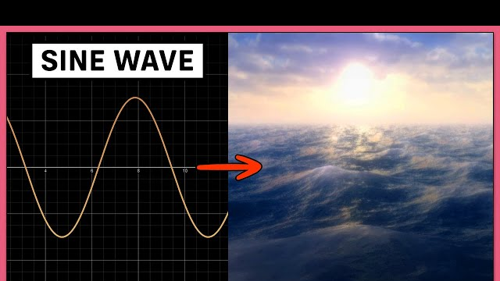
How Realistic?

Slide 16

Procedural Animation
Pros:
Time saving
Realistic
Dynamic / Easy to manipulate
Cons:
Not performance friendly
Simulation can be tricky to control 100%

Slide 17
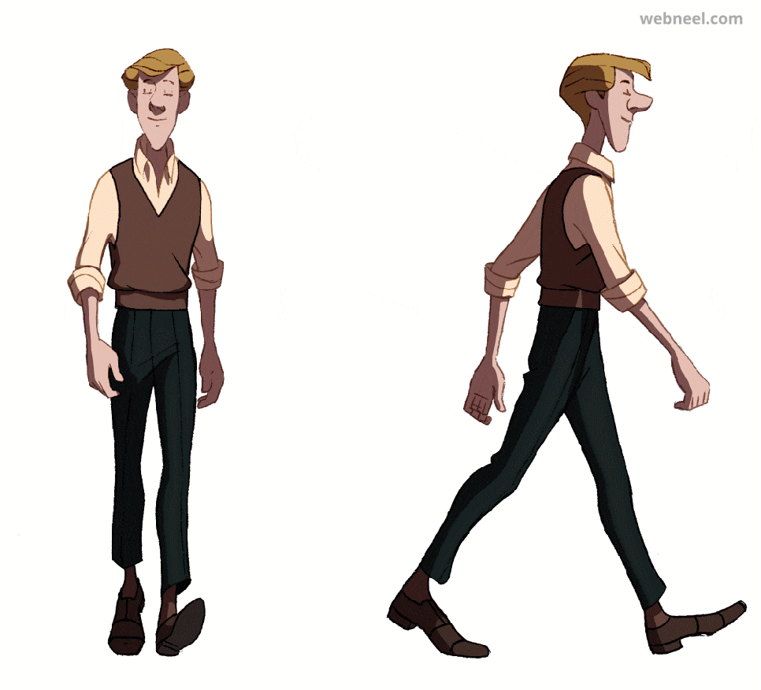
Keyframe Animation Character vs Non-Character
Pros:
Performance Friendly
Artist Friendly
100% Control
Cons:
Static? IK?
Difficult for programmers to tweak?
Time Consuming
Only applies to transformations

Slide 18
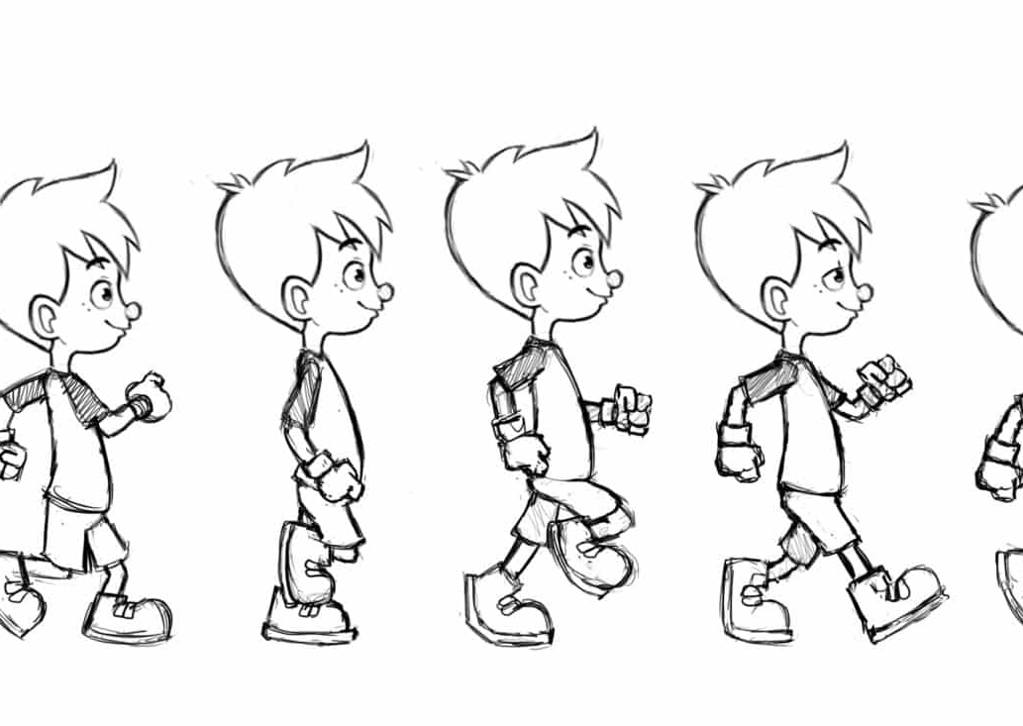
What is Keyframe Animation?
Keyframe animation mimicks traditional hand drawn animation.
Has anyone tried to animate by hand?
An animator will draw key poses/frames first and fill in keys in-between.
The computer is doing all the hard work for animators (Remember LERP?)
Keyframe animation for computers equals manipulation of transformations (matrix?)

Slide 19
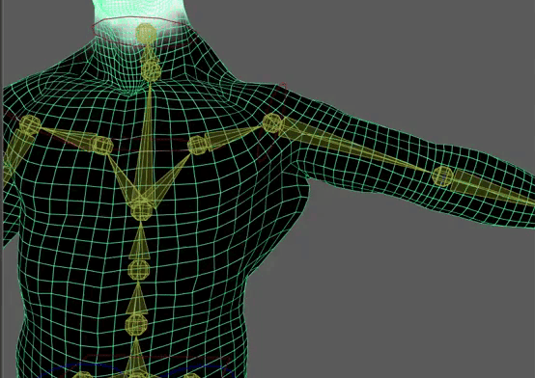
What is character rigging?
To animate a 3D character requires a rig
Skeletal Bonesystem
Deformers
Vertex Weighting
Test and refine
Why is rigging hard?

Slide 20


